Slide 1
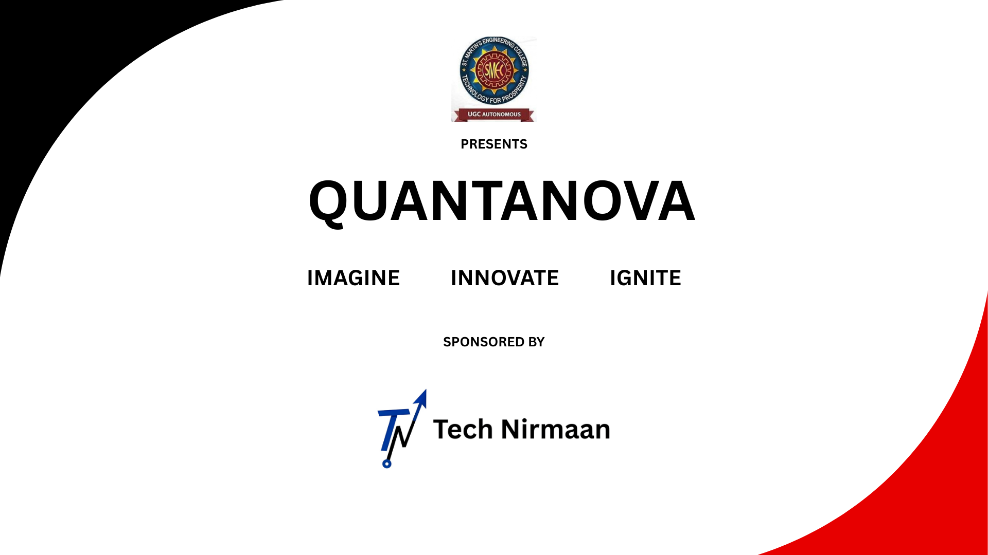

Slide 2

Team Details-
Team name: The Overclockers
Team leader name: Ravi teja
Problem statement: Develop a voice enabled assistant for visually impaired students to access books.

Slide 3
Brief about the idea
We propose a voice-enabled AI assistant that allows visually impaired students to access, navigate, and interact with academic books and materials through speech-based commands.
It uses text-to-speech (TTS) and speech-to-text (STT) technology combined with natural language understanding (NLU) to provide a smooth interaction and switching between user’s command and AI Voice.

Slide 4
List of features offered by the solution
Voice-activated book search and access
Page/paragraph navigation via voice
Text-to-speech for scanned or digital books
Summarization of content on request
Voice-based Q&A
Bookmarking and note-taking using voice
The assistant Consists of only One Interface, that is Upper half with a designed Assistant name that is BookMania and bottom half with attractive Voice button

Slide 5
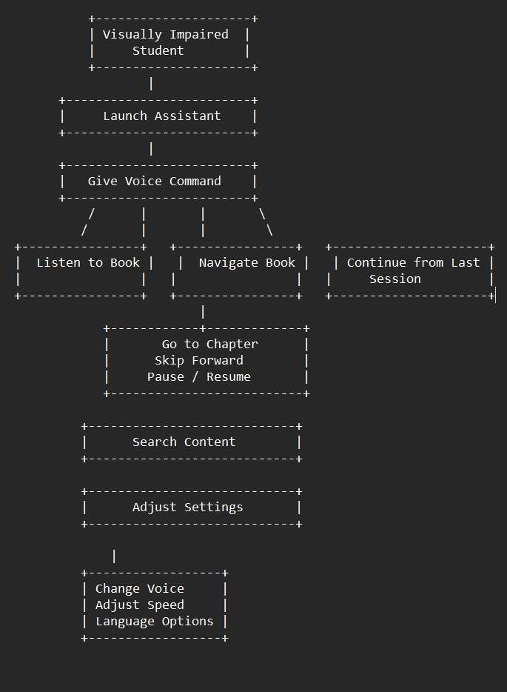
Process flow diagram or use-case diagram

Slide 6
Technologies to be used in the solution
Frontend (UI Layer) – Tkinter
AI / NLP Layer - Hugging Face Transformers
(transformers library)
Book Handling - PyPDF2
Backend / Scripting - Python 3.9+
• Speech-to-Text: Google Speech API, Whisper by OpenAI
• Text-to-Speech: Amazon Polly, Google TTS, Azure TTS
• OCR (for scanned books): Tesseract OCR
• Natural Language Processing: OpenAI GPT, Spacy
Package Management - pip + virtualenv

Slide 7
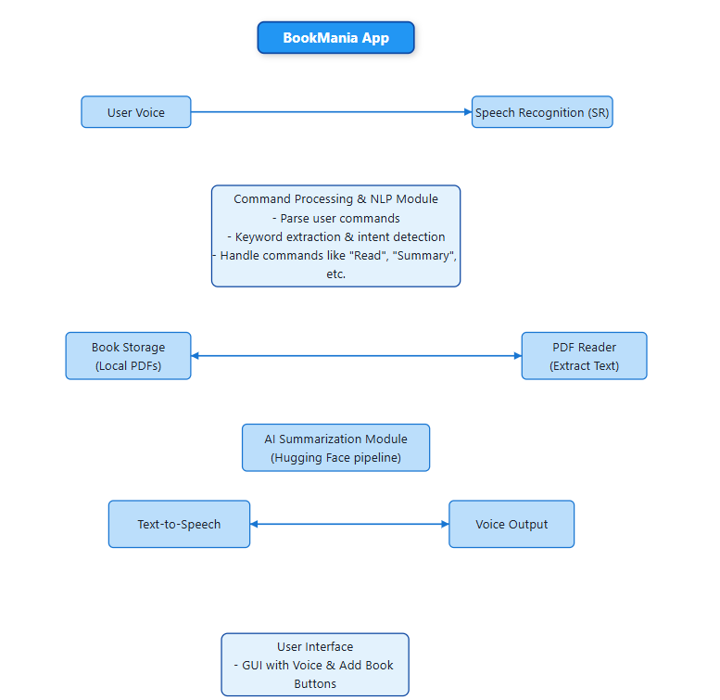
Architecture diagram of the proposed solution

Slide 8
Thank You

